Slide 1
DC Metro Chapter
Host of the 2015 Convention
July 3 – 5, 2015
Notes:
This slide can be used as a background before the presentation begins.

Slide 2
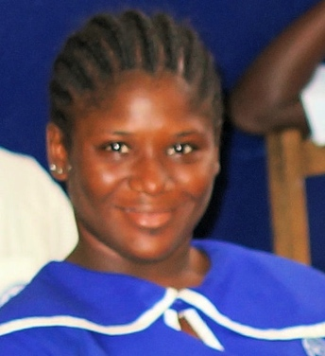


D. C. Metro Chapter
2015 Convention Presentation
Mona Diggs
President
Notes:
This template is in widescreen format and demonstrates how transitions, animations, and multimedia choreography can be used to enrich a presentation.

Slide 3
October 10, 2014
Meeting of the Executive Board
University of Maryland University College
Marriott Hotel & Conference Center
3501 University Blvd
East Hyattsville Maryland 20783

Slide 4
October 11, 2014
The Rev. Dr. Emmanuel W. Johnson Honoring Program
Kahler Hall
5440 Old Tucker Road
Columbia Maryland 21044

Slide 5
DC Metro Chapter - Host of more Conventions than any other chapter:
1993 Convention (1st Convention)
Convention (6th Convention) Theme: “We have made a difference”
2002 Convention (10th Convention) Theme: “Our pride and our promise”
2008 Convention (16th Convention) Theme: “A new beginning”

Slide 6
B. W. Harris Episcopal School Alumni Association-USA, Inc.
The 23rd Annual Convention will be hosted by DC Metro Chapter during July 3 - 5, 2015. The Class of 1980 will also hold its 35th Anniversary event on Thursday, July 2, 2014, and we will honor the late Bishop Bravid Washington Harris for whom our school is named during the Convention.

Slide 7
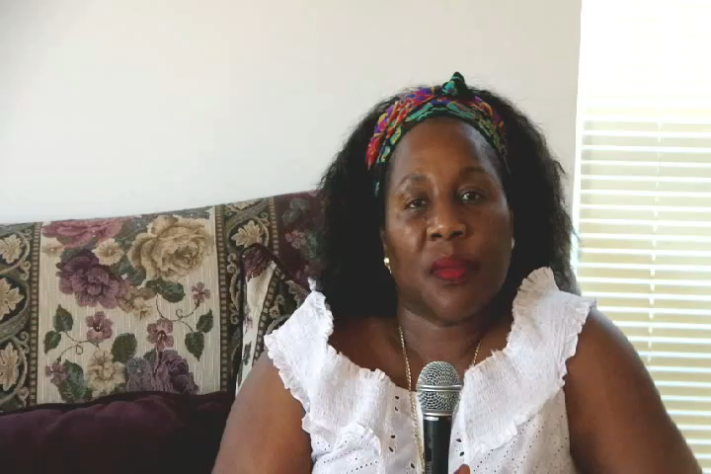
Statement by Mona Diggs

Slide 8
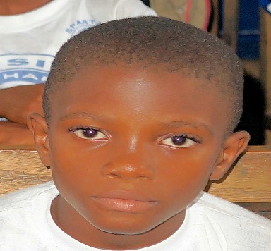
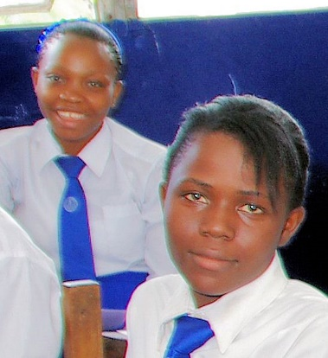
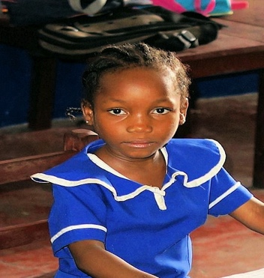
Our 2015 Convention theme
Beyond
Boundaries
Yes
We make it happen!

Slide 9
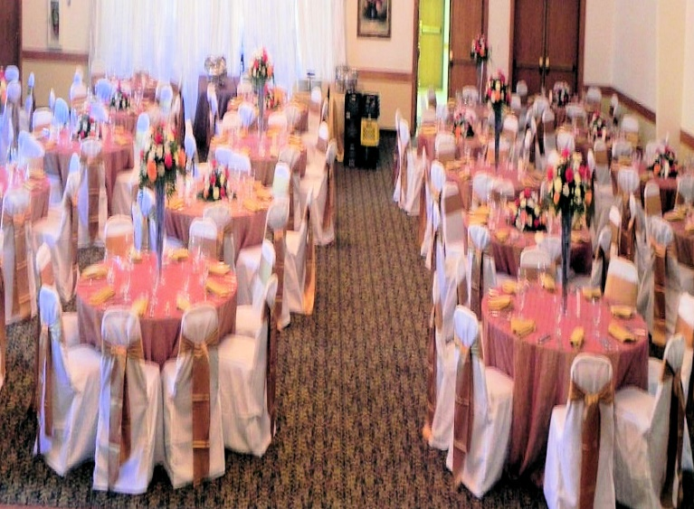
Class of 1980
35th Anniversary
Thursday, July 2, 2015
St. Andrews Grand Hall
15100 New Hampshire Avenue
Silver Spring MD 20905
Congratulations Malamu
$25.00 Entrance

Slide 10
2015 Convention

Slide 11
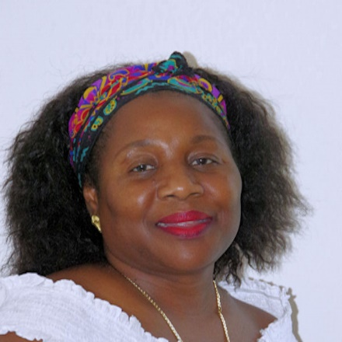



DC Metro Chapter

Slide 14

Executive Board Meeting, Welcome Party, Chairman’s Ball, Picnic, Farewell Party
July 3 – 5, 2015
St. Andrew’s Grand Hall
15100 New Hampshire Avenue
Silver Spring MD 20905
“St. Andrew’s is centrally located in Silver Spring, Maryland with easy access to Washington DC and the suburbs.

Slide 15
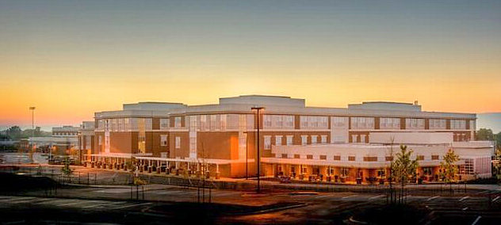
General Convention Meeting
Saturday, July 4, 2015
Paint Branch High School
14121 Old Columbia Pike
Silver Spring MD 20903
The Convention is the highest decision-making body of the Association

Slide 16
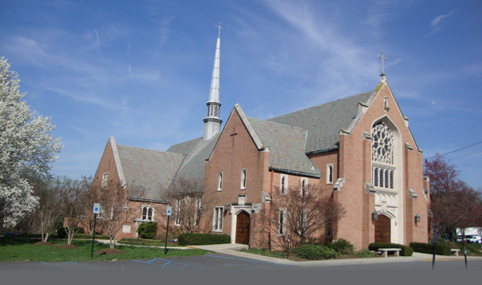
Episcopal Church of Our Savior
Sunday, July 5, 2015
1700 Powder Mill Road
Silver Spring MD 20903
Vision: “to be a home for all of God’s people”

Slide 17
DC Metro Chapter is financial prepared to host the 2015 convention
Consistent with the Association’s requirement, DC Metro Chapter will present its 2015 Convention Budget to the Executive Board during its October 2014 meeting .
The budget will cover hall rental for the meeting and social activities, catering, food, drinks, DJ(s), photography and other expenses.

Slide 18
Airport/Airlines/Car Rental/Hotel
Details including 800 numbers and web addresses for airlines, car rental and hotel information will be available on the web site after this Convention.

Slide 19
Airports serving the DC Metro Area
BWI Thurgood Marshall
Washington Ronald Reagan
Dulles International

Slide 20
Airlines Serving the DC Metro Area
American/US Air United
Delta Virgin America
Jet Blue Southwest
Alaska Spirit

Slide 21
Car Rental Serving the DC Metro Area
Enterprise Hertz
Alamo/National Budget
Avis Dollar
Zip Car Thrifty
Advantage

Slide 22
Hotels Serving Silver Spring MD
Marriott Courtyard Sheraton Comfort Inn
Hilton Garden Inn Marriott Residence Inn
Hampton Inn Double Tree Days Inn
Travelodge Homewood Suites

Slide 23
DC Metro Chapter
2015 Convention
Beyond Boundaries.
YES!
We make it happen!
Raise funds
Celebrate our Association
Support our school

Slide 24
DC Metro Chapter
The 2015 Convention will mark the 55th year of the founding of B. W. Harris Episcopal School and the 23rd year of the founding of our Association.
We will also be celebrating the very successful administration led by our National Chair Gudrun Harris, and bring in new leadership to continue this positive legacy.
2015 is a milestone year and we intend to host a milestone Convention.
- Mona Diggs, President

Slide 25
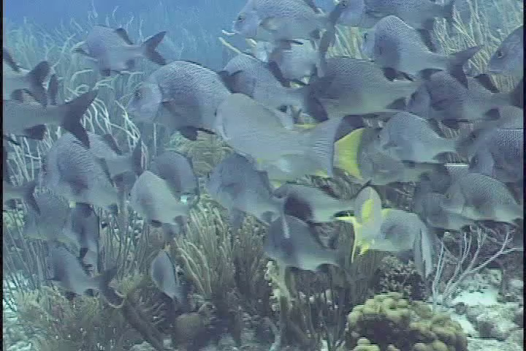
DC Metro Chapter
Thank You for your attention
We look forward to seeing you next year.
Let us make the 2014 Convention here in Charlotte, North Carolina a successful one.

Slide 26
DC Metro Chapter
Any questions?

